Slide 1
UNIT 1: Introduction to Machine Learning (Lecture 1)

Slide 2
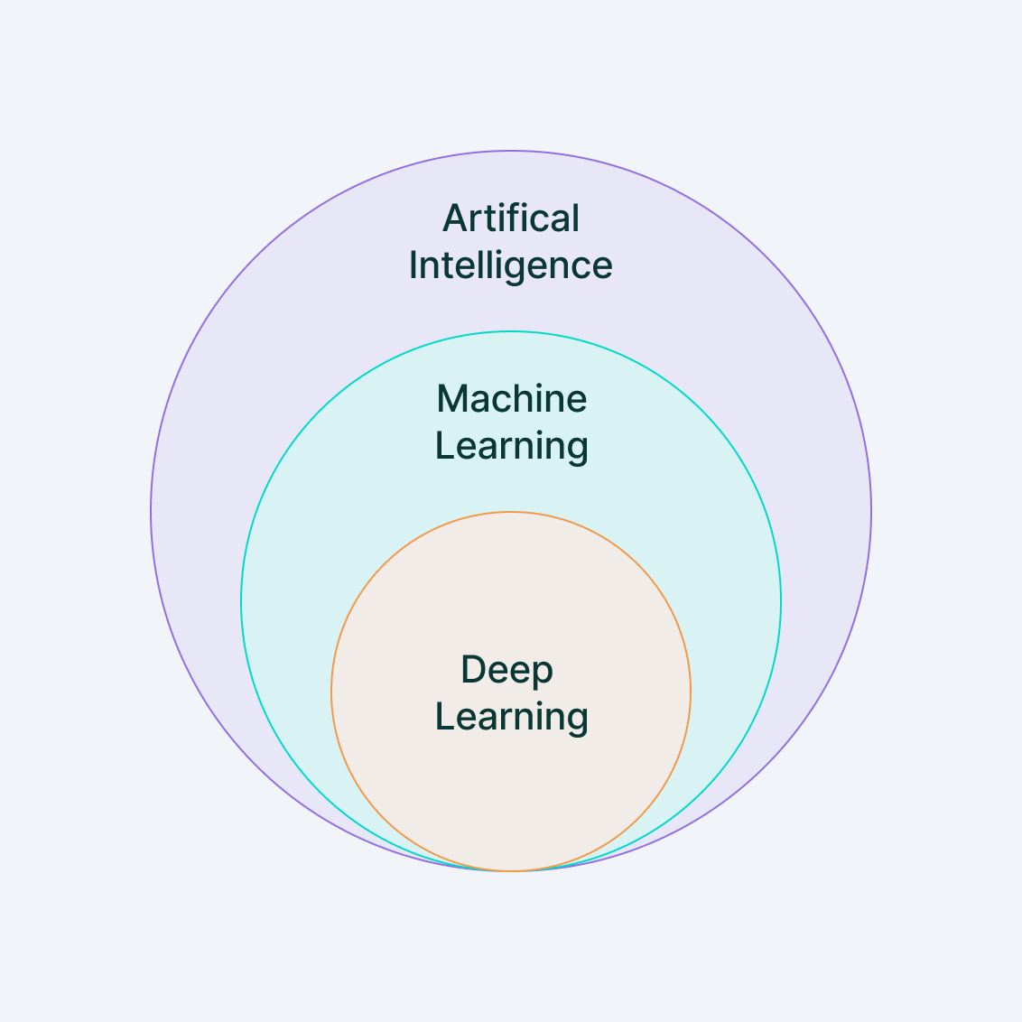
What is Machine Learning?
Machine learning is a branch of artificial intelligence (AI) and computer science which focuses on the use of data and algorithms to imitate the way that humans learn, gradually improving its accuracy.
Artificial intelligence (AI) refers to computer systems capable of performing complex tasks that historically only a human could do, such as reasoning, making decisions, or solving problems.

Slide 3
Need of Machine Learning:
The need for machine learning arises from various challenges and opportunities in different domains. Here are some key reasons why machine learning is important:
Handling Complex and Large Data Sets: In today's world, we generate and accumulate massive amounts of data. Traditional methods of analysis and processing may be insufficient to extract meaningful insights from these large datasets. Machine learning algorithms are capable of handling complex and big data, identifying patterns, and making predictions.
Automation and Efficiency: ML enables automation of tasks that would be difficult or time-consuming for humans to perform manually. This leads to increased efficiency and productivity in various industries, as machines can learn from data and adapt to new information without explicit programming.
Pattern Recognition: Machine learning excels at recognizing patterns and trends in data. This capability is crucial in fields such as image and speech recognition, where the system learns to identify objects, faces, or spoken words by analyzing patterns in data.
Personalization: ML algorithms power recommendation systems in various applications, such as e-commerce, streaming services, and social media. These systems analyze user behavior and preferences to provide personalized recommendations, enhancing user experience.
Prediction and Forecasting: ML models can be trained to make predictions and forecasts based on historical data. This is valuable in fields like finance, weather prediction, and healthcare, where accurate predictions can have significant implications.

Slide 4
Natural Language Processing (NLP): NLP is a subfield of ML that focuses on enabling computers to understand, interpret, and generate human language. This is essential for applications like chatbots, language translation, sentiment analysis, and voice recognition.
Fraud Detection and Security: ML can be employed to detect anomalies and patterns indicative of fraudulent activities in financial transactions, network security, and other domains, enhancing the ability to identify and prevent fraudulent behavior.
Healthcare and Medicine: ML has the potential to revolutionize healthcare by analyzing medical data, predicting disease outbreaks, assisting in diagnostics, and personalizing treatment plans based on individual patient data.
Autonomous Systems: Machine learning plays a crucial role in the development of autonomous systems, such as self-driving cars and drones, by enabling them to perceive and respond to their environment based on learning from data.
Continuous Improvement: ML models can adapt and improve over time as they are exposed to new data. This adaptability allows systems to evolve and stay relevant in dynamic environments.

Slide 5
Types of Machine Learning:

Slide 6
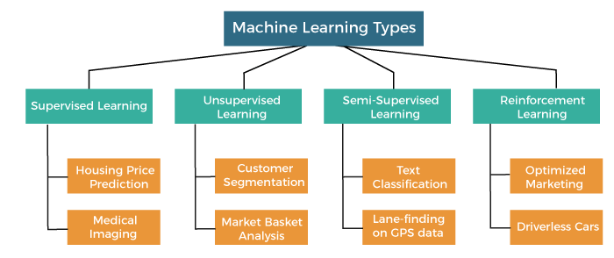

Slide 7
Based on the methods and way of learning, machine learning is divided into mainly four types, which are:
Supervised Machine Learning
Unsupervised Machine Learning
Semi-Supervised Machine Learning
Reinforcement Learning

Slide 8
Let us discuss types of machine learning in details:
1. Supervised Machine Learning
Supervised learning is defined as when a model gets trained on a “Labelled Dataset”.
Labelled datasets have both input and output parameters.
In Supervised Learning algorithms learn to map points between inputs and correct outputs. It has both training and validation datasets labelled.
There are two main categories of supervised learning that are mentioned below:
Classification
Regression

Slide 9
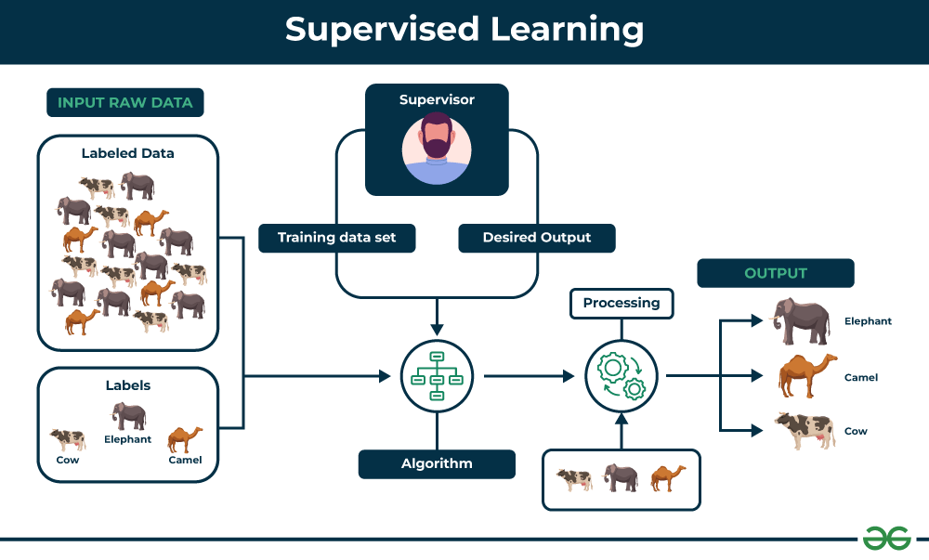

Slide 10
2. Unsupervised Machine Learning
Unsupervised Learning Unsupervised learning is a type of machine learning technique in which an algorithm discovers patterns and relationships using unlabeled data.
Unlike supervised learning, unsupervised learning doesn’t involve providing the algorithm with labeled target outputs.
The primary goal of Unsupervised learning is often to discover hidden patterns, similarities, or clusters within the data, which can then be used for various purposes, such as data exploration, visualization, dimensionality reduction, and more.
There are two main categories of unsupervised learning that are mentioned below:
Clustering
Association

Slide 11
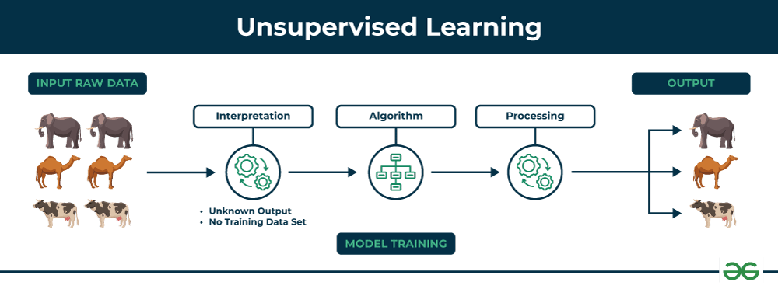

Slide 12
3. Semi-Supervised Learning
Semi-Supervised learning is a machine learning algorithm that works between the supervised and unsupervised learning so it uses both labelled and unlabeled data.
It’s particularly useful when obtaining labeled data is costly, time-consuming, or resource-intensive.
Semi-supervised learning is chosen when labeled data requires skills and relevant resources in order to train or learn from it.
We use these techniques when we are dealing with data that is a little bit labeled and the rest large portion of it is unlabeled.
We can use the unsupervised techniques to predict labels and then feed these labels to supervised techniques. This technique is mostly applicable in the case of image data sets where usually all images are not labeled.

Slide 13
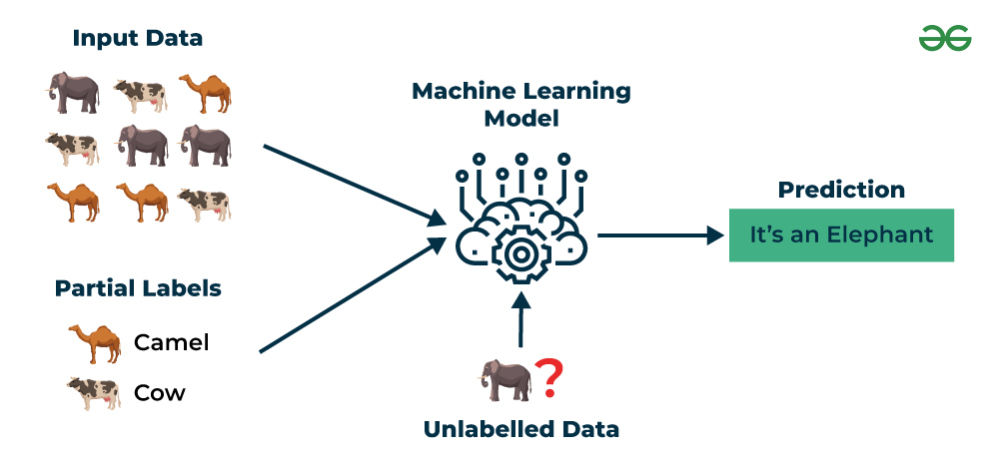

Slide 14
4. Reinforcement Learning
Reinforcement learning is a machine learning paradigm that focuses on training intelligent agents to make sequences of decisions in order to maximize a cumulative reward signal.
It is inspired by behavioral psychology and is often used in scenarios where an agent interacts with an environment to learn a policy that helps it achieve a specific goal over time.
Reinforcement Learning (RL) is the science of decision making. It is about learning the optimal behavior in an environment to obtain maximum reward.
In RL, the data is accumulated from machine learning systems that use a trial-and-error method. Data is not part of the input that we would find in supervised or unsupervised machine learning.

Slide 15
Reinforcement learning uses algorithms that learn from outcomes and decide which action to take next.
After each action, the algorithm receives feedback that helps it determine whether the choice it made was correct, neutral or incorrect.
It is a good technique to use for automated systems that have to make a lot of small decisions without human guidance.
“Reinforcement learning is an autonomous, self-teaching system that essentially learns by trial and error. It performs actions with the aim of maximizing rewards, or in other words, it is learning by doing in order to achieve the best outcomes.”

Slide 16
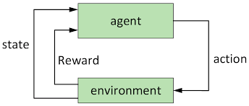

Slide 17
MCQ:
Where can we apply supervised learning?
Analyzing spam emails
Image recognition
Sentiment analysis
All of the above

Slide 18
MCQ:
Where can we apply supervised learning?
Analyzing spam emails
Image recognition
Sentiment analysis
All of the above

Slide 19
Well Posed Learning Problems:
Well Posed Learning Problem – A computer program is said to learn from experience E with respect to some class of tasks T and performance measure P, if its performance at tasks T, as measured by P, improves with experience E.
Any problem can be segregated as well-posed learning problem if it has three traits –
Task
Performance Measure
Experience

Slide 20
Examples that efficiently defines the well-posed learning problem are –
To better filter emails as spam or not:
Task – Classifying emails as spam or not
Performance Measure – The fraction of emails accurately classified as spam or not spam
Experience – Observing you label emails as spam or not spam

Slide 21
2. Fruit Prediction Problem
Task – forecasting different fruits for recognition
Performance Measure – able to predict maximum variety of fruits
Experience – training machine with the largest datasets of fruits images
3. Face Recognition Problem
Task – predicting different types of faces
Performance Measure – able to predict maximum types of faces
Experience – training machine with maximum amount of datasets of different face images

Slide 22
Designing a Learning System in Machine Learning :
According to Tom Mitchell, “A computer program is said to be learning from experience (E), with respect to some task (T). Thus, the performance measure (P) is the performance at task T, which is measured by P, and it improves with experience E.”
Example: In Spam E-Mail detection,
Task, T: To classify mails into Spam or Not Spam.
Performance measure, P: Total percent of mails being correctly classified as being “Spam” or “Not Spam”.
Experience, E: Set of Mails with label “Spam”

Slide 23
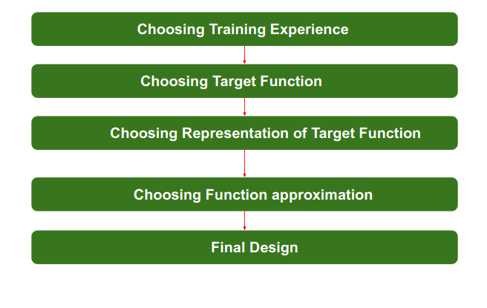
Steps for Designing Learning System are:

Slide 24
Step 1) Choosing the Training Experience:
The very important and first task is to choose the training data or training experience which will be fed to the Machine Learning Algorithm.
It is important to note that the data or experience that we fed to the algorithm must have a significant impact on the Success or Failure of the Model.
So Training data or experience should be chosen wisely.

Slide 25
Below are the attributes which will impact on Success and Failure of Data:
The training experience will be able to provide direct or indirect feedback regarding choices. For example: While Playing chess the training data will provide feedback to itself like instead of this move if this is chosen the chances of success increases.
Second important attribute is the degree to which the learner will control the sequences of training examples. For example: when training data is fed to the machine then at that time accuracy is very less but when it gains experience while playing again and again with itself or opponent the machine algorithm will get feedback and control the chess game accordingly.
Third important attribute is how it will represent the distribution of examples over which performance will be measured. For example, a Machine learning algorithm will get experience while going through a number of different cases and different examples. Thus, Machine Learning Algorithm will get more and more experience by passing through more and more examples and hence its performance will increase.

Slide 26
Step 2- Choosing target function:
The next important step is choosing the target function.
It means according to the knowledge fed to the algorithm the machine learning will choose NextMove function which will describe what type of legal moves should be taken.
For example : While playing chess with the opponent, when opponent will play then the machine learning algorithm will decide what be the number of possible legal moves taken in order to get success.

Slide 27
Step 3- Choosing Representation for Target function:
When the machine algorithm will know all the possible legal moves the next step is to choose the optimized move using any representation i.e. using linear Equations, Hierarchical Graph Representation, Tabular form etc.
The NextMove function will move the Target move like out of these move which will provide more success rate. For Example : while playing chess machine have 4 possible moves, so the machine will choose that optimized move which will provide success to it.

Slide 28
Step 4- Choosing Function Approximation Algorithm:
An optimized move cannot be chosen just with the training data.
The training data had to go through with set of example and through these examples the training data will approximates which steps are chosen and after that machine will provide feedback on it.
For Example : When a training data of Playing chess is fed to algorithm so at that time it is not machine algorithm will fail or get success and again from that failure or success it will measure while next move what step should be chosen and what is its success rate.

Slide 29
Step 5- Final Design:
The final design is created at last when system goes from number of examples, failures and success, correct and incorrect decision and what will be the next step etc.
Example: DeepBlue is an intelligent computer which is ML-based won chess game against the chess expert Garry Kasparov, and it became the first computer which had beaten a human chess expert.

Slide 30
Statistical Learning Framework
Statistical Model:
A mathematical process that attempts to describe the population from which a sample came, which allows us to make predictions of future samples from that population.
Examples: Hypothesis testing, Correlation, etc.

Slide 31
Some problem statements solved by statistical modeling:
employing inferential statistics to calculate the average income of a population from a random sample
estimating a stock’s future price using previous data, and time series analysis.
Objectives of Statistical Model:
used for proving any result such as hypothesis testing, and p-value.
search data for interesting information (exploratory) such as generating hypotheses.
building a protective model.

Slide 32
Assumptions in Statistical Model:
Independence, states that there shouldn’t be any relationships between the observations in the collection.
Normality requires that the response variable’s distribution is approximately normal, with data symmetric around the mean.
Linearity indicates that the relationship between the response variable and predictor variable(s) should be linear.
No multicollinearity, suggesting the independence of predictor variables from each other.
outliers, the dataset should not contain any outliers that may influence the results.

Slide 33
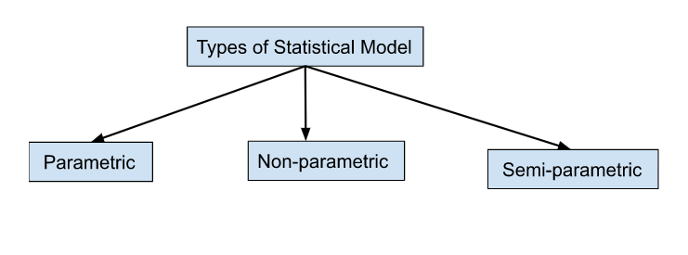
The group of probability distributions that have a finite number of parameters is known as parametric.
Nonparametric models are those where the kind and quantity of parameters are adjustable and not predetermined.
Semiparametric means that the parameter has both a parametric and a non-parametric.

Slide 34
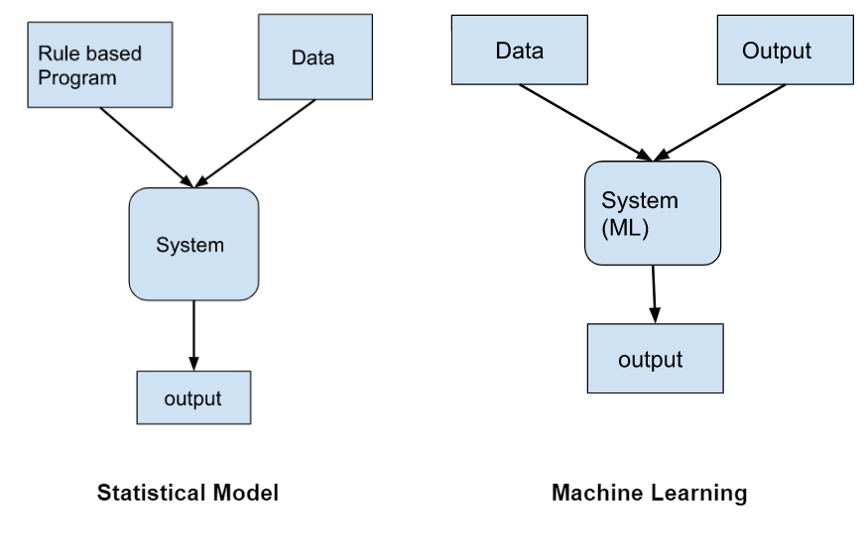

Slide 35
Difference between Statistical Model and ML model

Slide 36
Statistical Model | Machine Learning
The relationship between variables is found in the form of mathematical equations. | The relationship between variables is finding out by the self-learning algorithm that learns from the data without relying on rule-based learning.
The purpose of statistical modeling is to find the relationship between variables and to test the hypothesis. | Machine learning is focused on making accurate predictions.
In Statistical Modeling takes a lot of assumptions to identify the underlying distributions and relationships. | In machine learning don’t rely on such assumptions.
More interpretable (able to exchange and make use of information) as compared to machine learning | Less interpretable and more complex
The model was developed on training data and tested on testing data. | The model was developed on training data and sometimes hyperparameters are tuned or validation data and finally get evaluated/tested again testing data.
Mostly used for research purposes | ML is implemented in a production environment
It is not best suited to a large amount of data. | It can range from small to large amounts of data sets
implicit programming requires human efforts to do statistical modeling | Explicit programming requires less human effort.
Best estimate relationship between variables | Strong predictive ability due to the ability to learn from past data.

Slide 37
Thank You!

